Slide 1
Business Process Engineering
Sobia Iftikhar

Slide 2
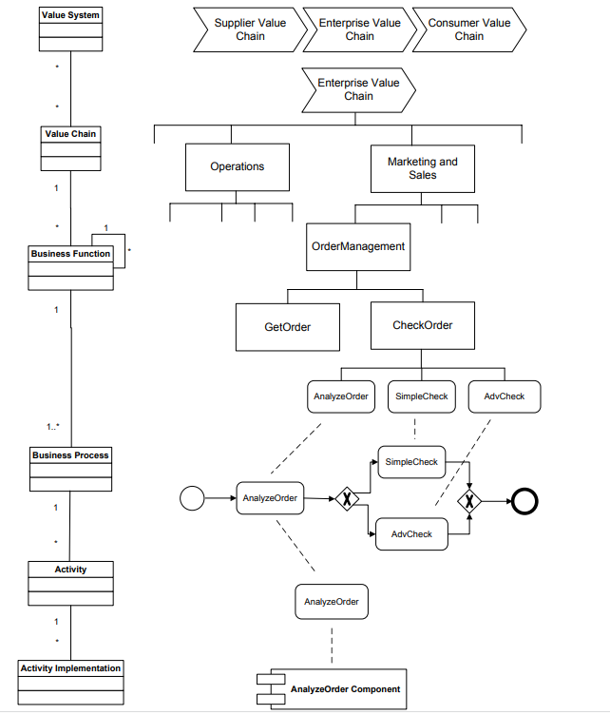
Activity Models and Activity Instances
Meta Object Facility
Levels of business process management. From value systems to activity implementations

Slide 3
Content
Properties of Business Processes & Business Process Management Architectures

Slide 4
Properties of Business Processes
Data Dependencies
Structural Soundness
Relaxed Soundness
Weak Soundness
Lazy Soundness
Soundness
Motivation of Soundness
Definition
Soundness Theorem

Slide 5
Data Dependencies
Application data are an integral part of business processes.
Data can be created, modified, and deleted during the execution of business processes.
Since business processes consist of a set of activities that are related, these activities operate on an integrated set of application data.
Data in business process models has two aspects, both of which need to be covered:
• Data that activity instances manipulate by invoking applications or services.
• Data dependencies between process activities.

Slide 6
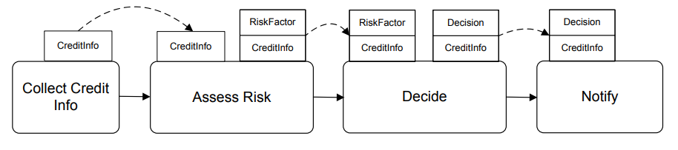
Data Dependencies
There are data dependencies between the activities mentioned
. Only when this data is available
An example of data flow in a business process in the financial sector is given. A credit approval business process contains activities to enter a credit request, to assess the risks of granting the credit, and to inform the customer about the decision made by the financial institution.

Slide 7
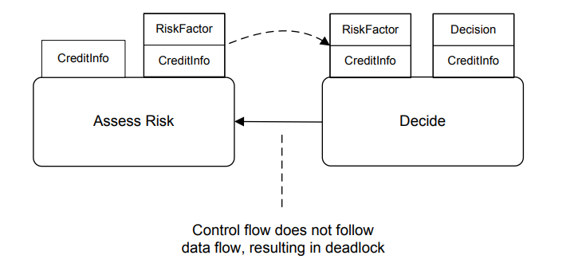
Data Dependencies
This property is known as control flow follows data flow.
Control flow needs to follow data flow, since otherwise the process instance would come to halt.
neither of these activities can be started, because control flow defines that Assess Risk can only start after Decide has completed, and Decide can only start after Assess Risk has generated the risk factor data value.
Data flow violated by control flow, resulting in deadlock

Slide 8
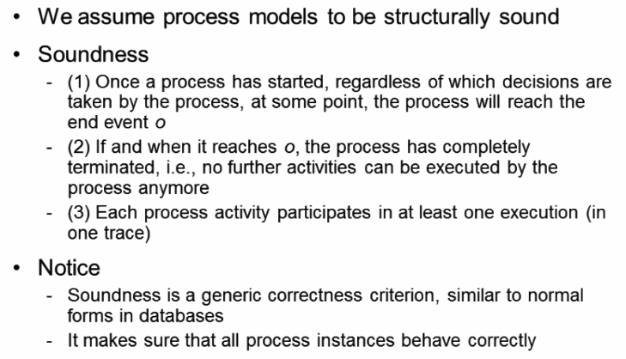
Soundness criterion

Slide 9
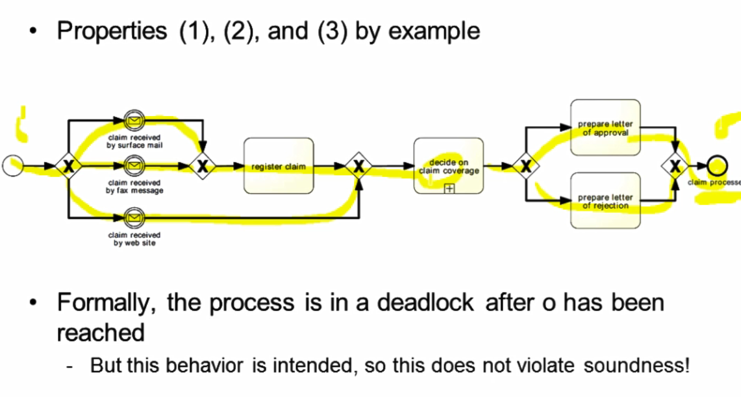
Soundness criterion-Properties

Slide 10
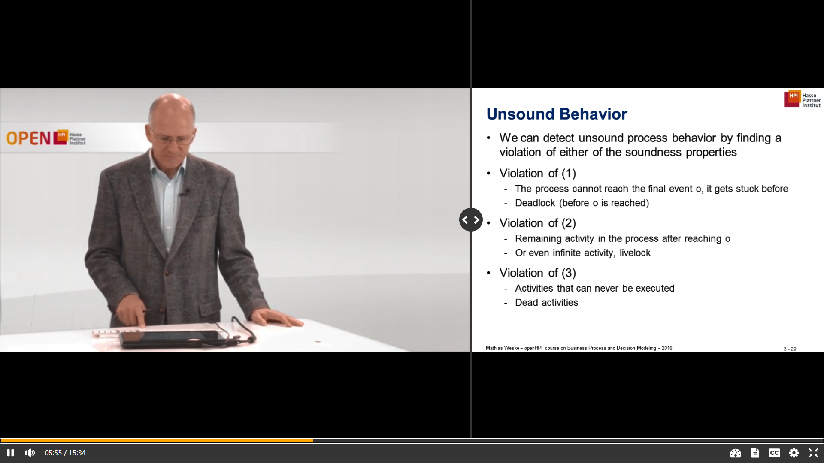
Unsound Behaviour

Slide 11
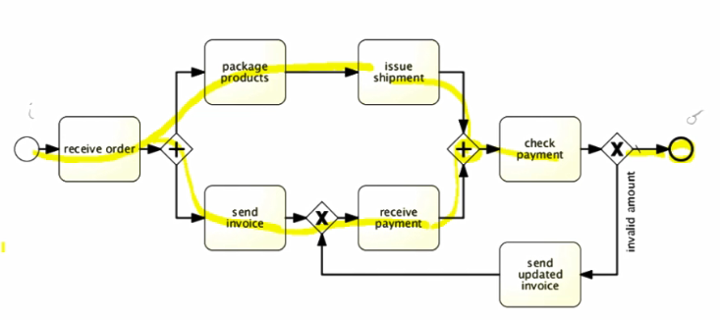
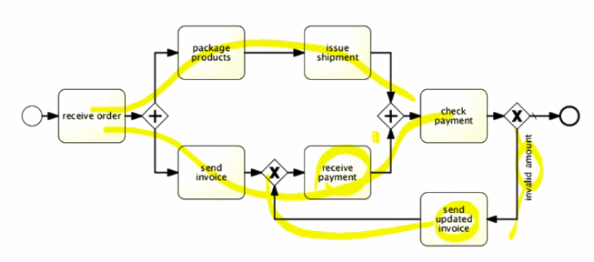
Violation 01-deadlock

Slide 12
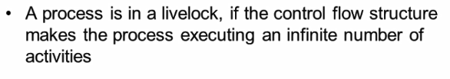
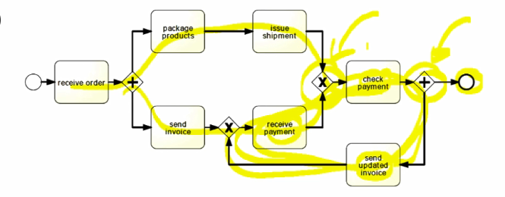
Violation 02

Slide 13
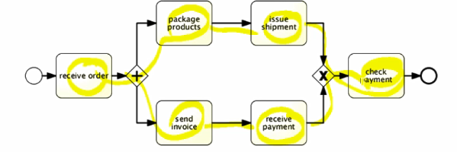
Violation 02-remaining

Slide 14
Violation 03-dead activities

Slide 15
Structural Soundness
Soundness assume that a process is structurally sound.
A process model is structurally sound if the criterion that a process model should fulfill. following conditions hold:
There is exactly one initial node, which is only node without any incoming edges. (i)
There is exactly one final node, which is only node without any outgoing edges. (o)
Each node in the process model is on a path from the initial node to the final node. (i) to (o)

Slide 16
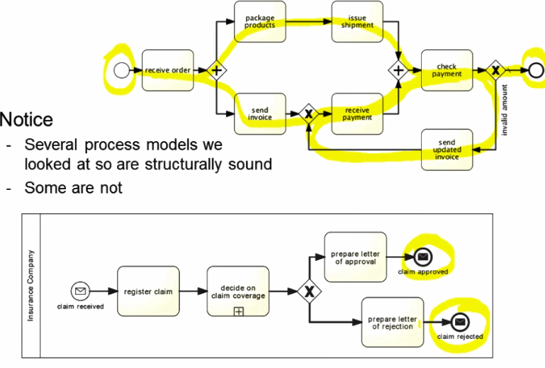
Example

Slide 17
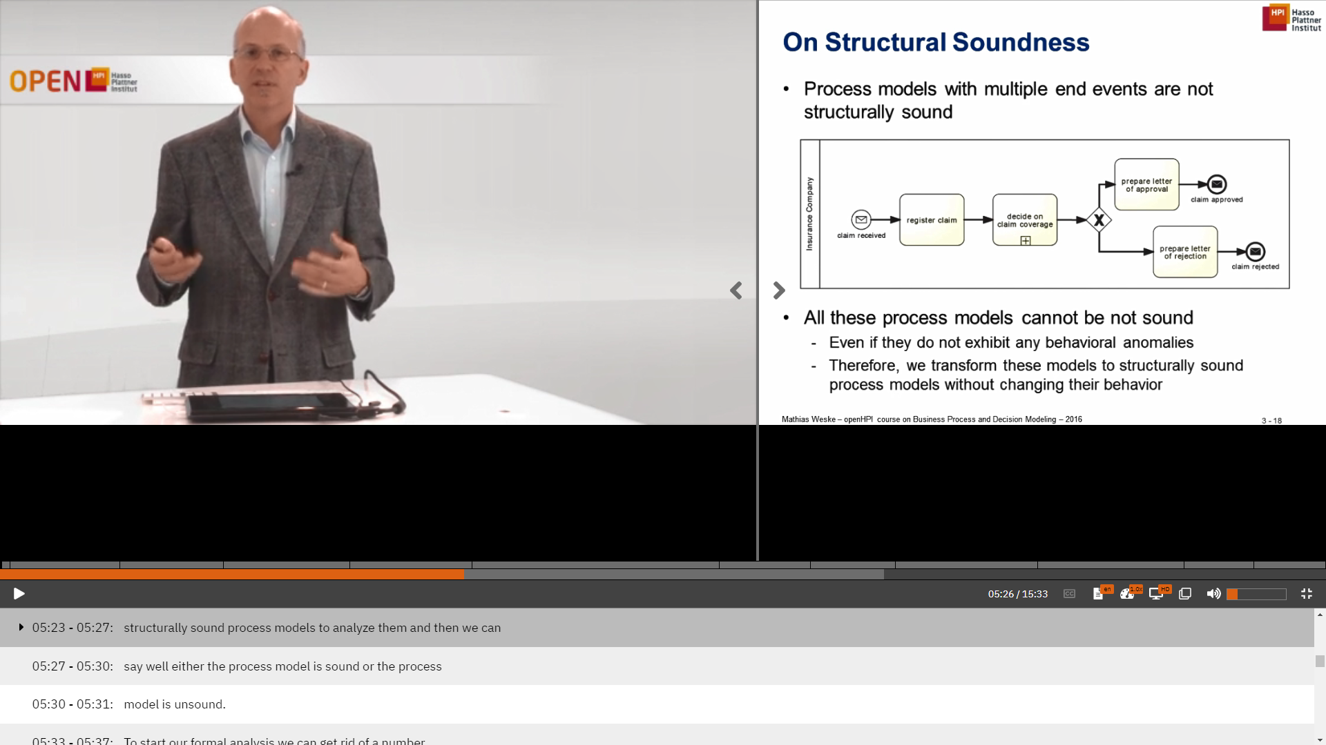
Structural Soundness

Slide 18
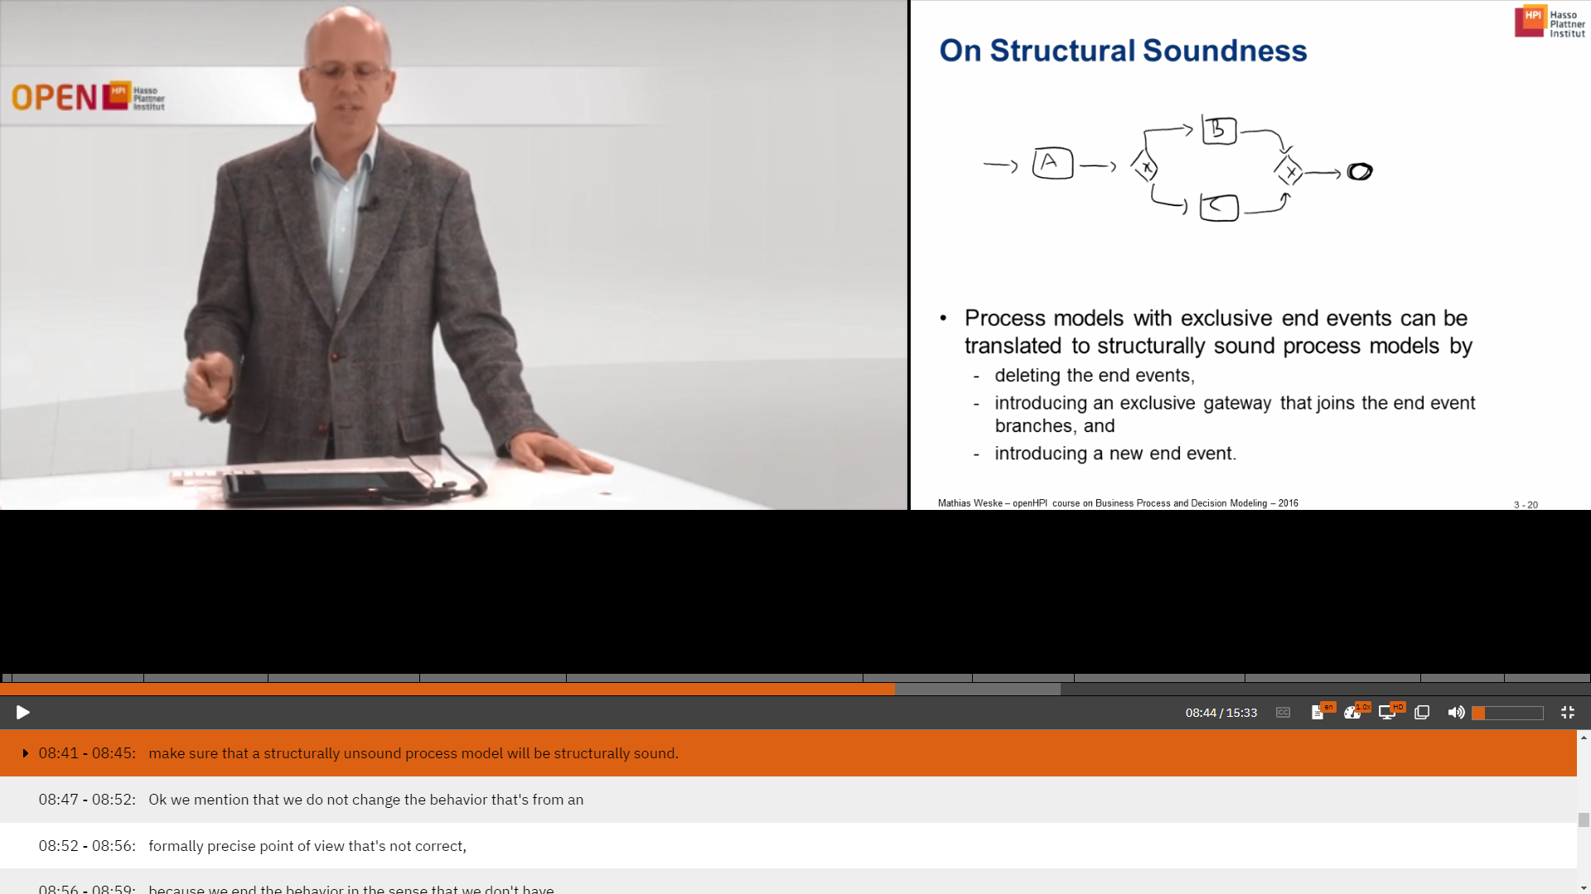
To start formal analysis
Now we transform the structurally unsound process into structurally sound process.

Slide 19
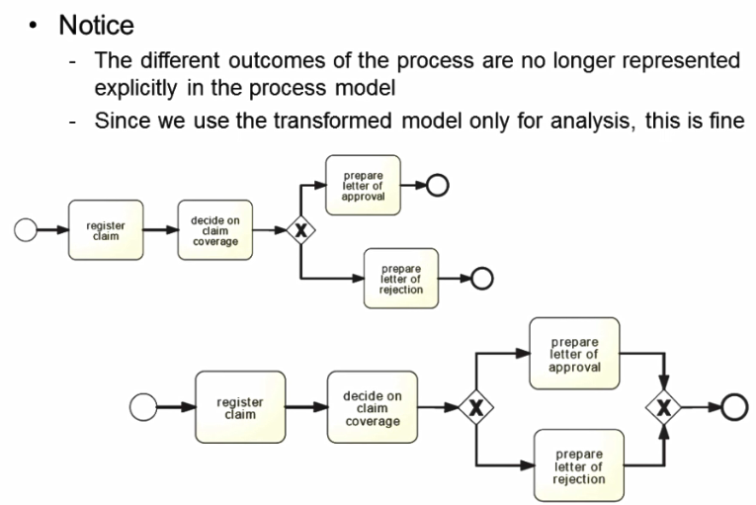
Structural sound

Slide 20
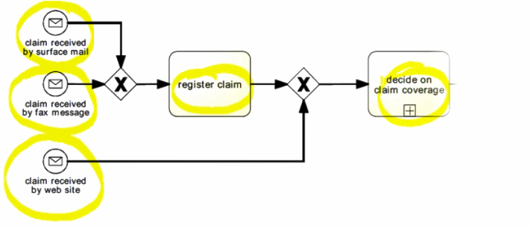
Multiple start Events.
We can see process models with multiple start week.

Slide 21
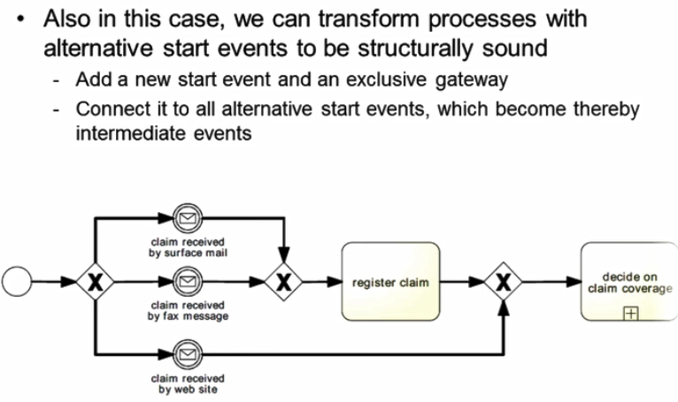
How to transform

Slide 22
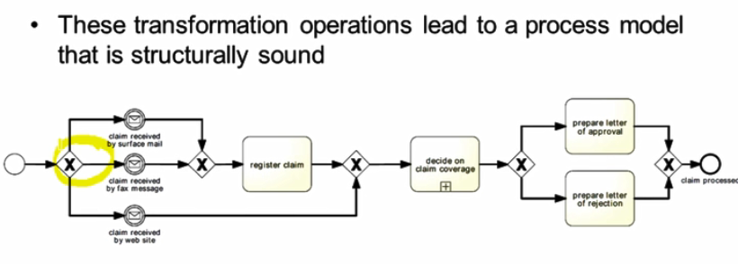

Slide 23
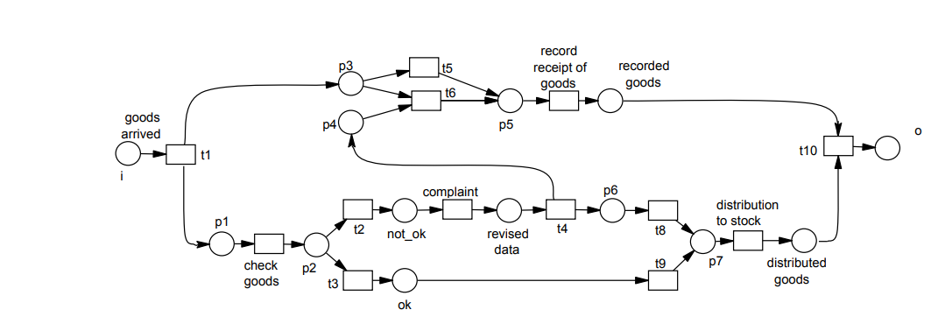
Relaxed Soundness
The idea of relaxed soundness is that for each transition there is a firing sequence that relaxed soundness allows business process models that expose deadlock behavior
A process is relaxed sound if each task of the business process is part of a properly terminating sequence..

Slide 24
